Slide 1

RTI²-B at
Bramble School
Staff Presentation

Slide 2
Notes on this Presentation
(Delete this slide)
This is an example presentation to share the plan with your entire staff.
Use this as a model for your presentation and be sure to add elements such as your school logo.
The yellow reference boxes are reminders of the workbook activities that match the slide.
Remember, all information is in this presentation is only an example and should be changed to match what your team developed in training.
Notes:
Delete this slide before presenting to your staff.

Slide 3
Materials in your RTI²-B Folder
Implementation Manual
  Includes more detailed information on every aspect of the plan
School Calendar
Lesson Plans
Posters for your room
Provide the entire staff with folders (paper or electronic) of all the information they need. ***Delete this shape/text box before presenting***
Notes:
You all should have the following materials:
A copy of our implementation manual. Read through the manual to have a thorough understanding of our school’s unique plan.
A copy of the school calendar. This has all of the pertinent dates for RTI²-B throughout the year.
Lesson plans. You will use these lesson plans to teach the expectations at the beginning of the year, and these can be used as refreshers throughout the year. We will talk more in depth about the lesson plans later in the presentation.
Posters for your room. These posters have the school-wide expectations. Display the posters in prominent locations in your classroom so they can be used as teaching tools and visual reminders for your students.

Slide 4

RTI²-B Definition
Response to Instruction and Intervention for Behavior (RTI²-B) is a systems approach to help districts, schools, staff, parents, and students align social and behavioral supports into one sustainable and effective multi-tiered, problem-solving framework.
Notes:
So what does this really mean? RTI²-B is a multi-tiered framework (like RTI for academics). The goal of RTI²-B is to help teach appropriate social and behavioral skills to students, while supporting students, staff, and families.

Slide 5
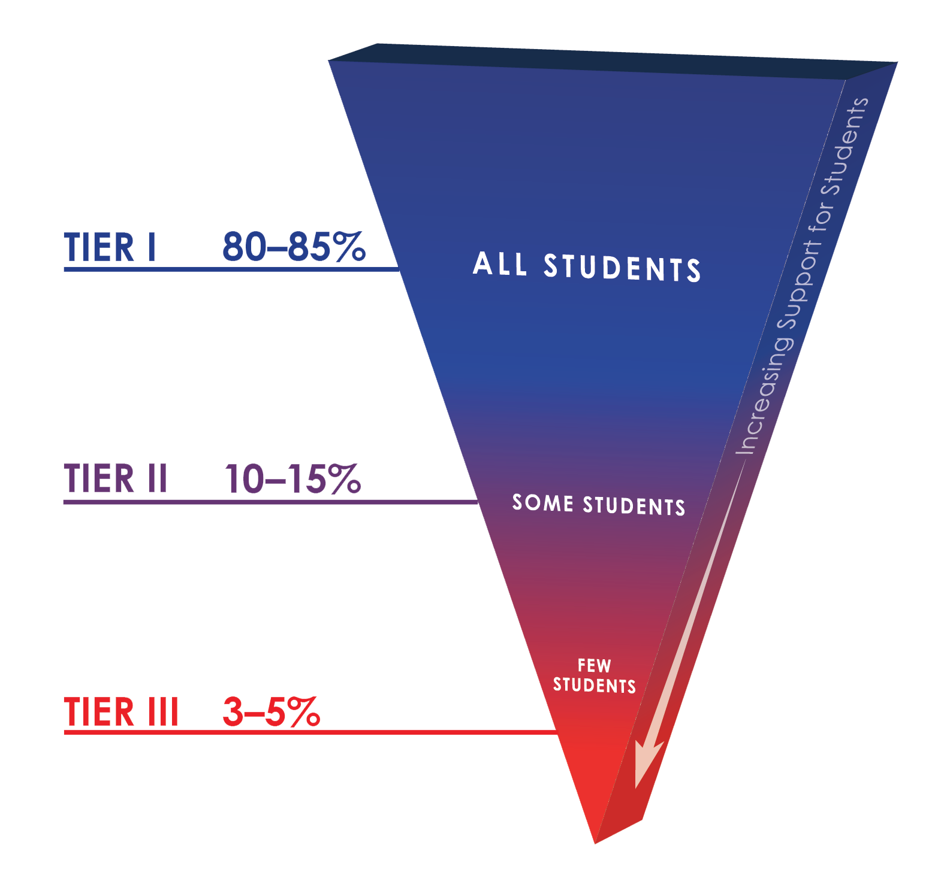

RTI²-B Overview
(Response to Instruction and Intervention for Behavior)
Notes:
This triangle should look familiar. It is the same triangle that we have for RTI for academics. RTI²-B is a multi-tiered framework. Today, we are going to be reviewing our school’s plan for Tier I. The practices that are part of our Tier I plan are for ALL students in our building. We anticipate the majority of students responding positively to the supports and practices in Tier I. But we also know that there are some students in our building who will require additional supports with Tier II, and a few students who will require individualized supports in Tier III.

Slide 6
RTI²-B School Team at Tier I Training
Attended Tier I Training over two days
Developed a draft for our Tier I implementation plan this year
Focused on:
  Providing supports for ALL students and staff
  Building relationships
  Improving School Culture and Climate
Need your input!
Notes:
We had a team of staff members go through the Tier I training with the Tennessee Behavior Supports Project. This team is our RTI²-B school team. We attended a 2-day training. At the training, we developed a draft of our school’s Tier I plan. In future trainings, we will develop our Tier II and Tier III plans. We focused on providing supports for ALL students and staff in our Tier I implementation plan. We also focused on developing positive relationships with our students and improving our school’s culture and climate. This is going to be a work in progress, and we need your input and feedback on the Tier I plan, as well as feedback throughout the school year on how the implementation is going.

Slide 7
Benefits of RTI²-B in Schools
(Horner et. al., 2014)
Notes:
Our state, district, and school have decided to implement RTI²-B because we know there are great benefits that schools have seen when implementing multi-tiered frameworks for behavior. Schools have seen increases in: time for academic instruction, parent/student/staff satisfaction, student achievement, student attendance, and school climate. And on the flipside, schools have seen decreases in: problem behaviors, staff turnover, bullying behaviors, office discipline referrals, suspensions, and expulsions.
Horner, R. H., Kincaid, D., Sugai, G., Lewis, T., Eber, L., Barrett, S., Rossetto Dickey, C., Richter, M., Sullivan, E., Boezio, C., Algozzine, B., Reynolds, H., & Johnson, N. (2014). Scaling up school-wide positive behavioral interventions and supports: Experiences of seven states with documented success. Journal of Positive Behavioral Interventions, 16(4), 197-208.

Slide 8

Shared Vision, Mission, Purpose
The purpose of our RTI²-B Team is to help develop a school-wide plan to improve school climate for all students, staff, and families. We will encourage building relationships between all stakeholders and will use input to when creating and modifying our plan to make sure all voices are heard.
Reference Activity #2 in Day 1 Workbook
& insert your school’s statement
Notes:
(Read your school’s mission or purpose statement)
We based our Tier I plan off of our school’s mission and purpose statements. These statements include our overall vision and goals for our school, including students, staff, and families. So we wanted to be sure to frequently reference our mission and purpose statements while developing our plan.

Slide 9
RTI²-B School Team
Meets on the 2nd Thursday of every month
Please feel free to contact any member with comments, questions, or feedback
Team Member | Team Role
Kyle Jonas | Facilitator, Team Lead
Jenny Oyer | Recorder
Jill Gutierrez | Communicator
Jordan O’Donnell | Data Analyst
Cat Baker | Time Keeper
Janine Robertson | Student Representative
Brooke O’Donnell | External Coach
Reference Activity #3 in Day 1 Workbook
and insert your team’s information
Notes:
This is our RTI²-B team. Our goal was to have representation of the staff by having different grade levels, related arts teachers, and specialty areas teachers on board. Like we have mentioned before, our school’s framework is an evolving one and we will continue to make changes over time to best meet the needs of our students, staff, and families. Therefore, we want you all to know that we are open to feedback and welcome your suggestions. We want you all to feel supported in this process, and we are here to be that support system for you.

Slide 10
What’s in Our Tier I Plan?
School-wide expectations
Teaching expectations
School-wide acknowledgement system
School-wide system for responding to inappropriate behaviors
Use of data
Professional development for staff
Notes:
So what exactly is in our Tier I plan? Our team has drafted a plan that includes the following practices: (1) school-wide expectations, (2) a plan for teaching those expectations, (3) a school-wide acknowledgement system (this includes acknowledging students, staff, and families), (4) a school-wide plan for responding to inappropriate behaviors, (5) a plan for using data to make decisions, and (6) additional professional development opportunities for our staff. We are going to talk about each of these things in more detail.

Slide 11


School-wide Behavioral Expectations
Posted in all locations in the school
Copies in your folders to post in your room
Bramble Behaviors
Be Safe
Be Respectful
Be Prepared
Reference Activity #5 in Day 1 Workbook &
list your expectations
Notes:
Our school has come up with (insert # of expectations) school-wide expectations. The expectations are: (read off the school-wide expectations). We will have the expectations posted throughout the building to serve as visual reminders to the students. We have also given you poster(s) to put in your classroom. These expectations are the same in every location in the school and are the same across grade levels. This consistency will help us as adults do a better job teaching the expectations, and will help students display more appropriate behaviors by having a better understanding of what the expectations are.

Slide 12
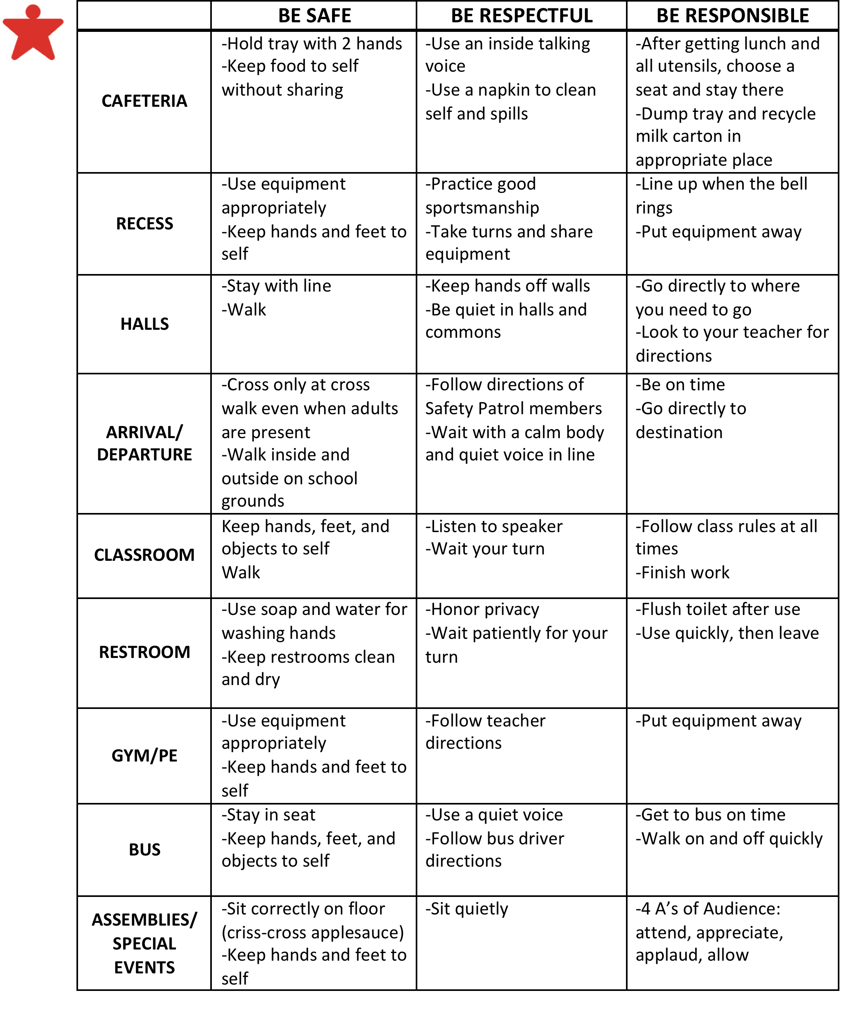
Behavioral Expectations Matrix
Reference Activity #6 in Day 1 Workbook and share your matrix
Notes:
Once we developed our school-wide expectations, our team had to decide on what those expectations looked like in the different settings in the school. For example, being responsible looks a little different in the cafeteria than the classroom, and being safe looks different in the hallways than on the playground. This is our behavioral expectations matrix that provides specific examples of what each school-wide expectation looks like in all of the locations in our school building. This matrix should be used as a reference tool for you as teachers. This would overwhelm our students if we showed it to them, and they would struggle to remember everything on the matrix. But we can use the matrix as teachers to help teach our students exactly what the school-wide expectations look like in the various settings and locations.

Slide 13
Initial Instruction on School-wide Behavioral Expectations
Team will teach the entire RTI²-B Plan to students at the assembly on the first day of school
Specials teachers will have classes rotate through each location to teach the RTI²-B lesson plans
Your folders have:
  Lesson plans for every setting
  Schedule for each grade level
  Rotations
  Materials needed
Reference Activity #7 in Day 1 Workbook and explain the plan to teach students
Notes:
Explain the plan for teaching the school-wide expectations to the students at the start of the year. This plan is found in activity #8 of your team’s workbook. This is crucial for staff to understand their role in teaching the plan to students at the start of the year.

Slide 14
Ongoing Instruction on School-wide Behavioral Expectations
Reteach lessons throughout the year:
  Quarterly assemblies to re-teach Behavioral Expectations
  After each break classroom teachers will re-teach specific lesson plans
  Daily reminders of behavioral expectations over morning announcements
Teaching new students
  School counselor will arrange a welcoming committee of student leaders to teach the new students
  Beginning of each month
Reference Activity #8 in Day 1 Workbook and explain the plan to teach students
Notes:
Once we have explicitly taught the school-wide expectations to the students at the start of the year, and allowed time for practice and feedback, the teaching doesn’t stop. Our students will need continued opportunities for behavioral instruction, practice, and feedback. This will be especially important following breaks from school, around changes in the daily routine, and when new students come into your classrooms.
(Explain the plan for ongoing instruction on the school-wide expectations. This plan is found in activity #9 of your team’s workbook. This is crucial for staff to understand their role in ongoing instruction throughout the year).

Slide 15

Acknowledging Students’ Appropriate Behavior
Tickets called Bramble Bucks
  Everyone is responsible for giving these to students exhibiting the behavioral expectations
  Pair with behavior-specific praise
Collect each classroom’s Bramble Bucks every Friday to post on The Beehive
  Whole school celebration when The Beehive is full
Bramble Buck
Bramble Middle School
Name: ___________________
Teacher: _________________
Expectation Met:
Reference Activity #18 in Day 2 Workbook & list your acknowledgement plan
Safe
Respectful
Prepared
Notes:
One of the foundational beliefs of RTI²-B is that students are not born with bad behavior; they learn that behavior over time. Therefore, with good instruction and reinforcement, students can learn socially-appropriate behaviors. Since we as teachers are experts in teaching new skills to students, we need to remember to teach and reinforce appropriate behavioral skills. The second step in the behavioral instruction process in Tier I is to acknowledge students’ appropriate behaviors. When we acknowledge students for demonstrating appropriate behaviors, they are much more likely to exhibit those behaviors again in the future. On the reverse, if we constantly acknowledge the inappropriate behaviors, students are much more likely to continue to display inappropriate behaviors. Therefore, we want to acknowledge students for demonstrating socially-appropriate behaviors that align with our school-wide expectations.
(Explain the plan for acknowledging students’ appropriate behavior. This plan is found in activity #12 of your team’s workbook. This is crucial for staff to understand their role in acknowledging students’ appropriate behavior).

Slide 16

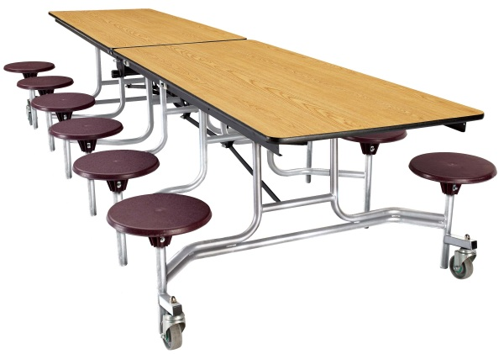
The Honey Pot Award
Every Friday, Honey Pot is given to the table of students that exhibit the most respectful, responsible, and safe behaviors in the cafeteria for that week
Honey Pot displayed in the middle of their table for the following week
Example Honey Pot Award
on Cafeteria Table
Notes:
(This is just an example of one of the acknowledgements at Bramble Elementary. If you have something similar, you can modify this slide to include your school’s information. If you do not have something like this, you can delete this slide).

Slide 17
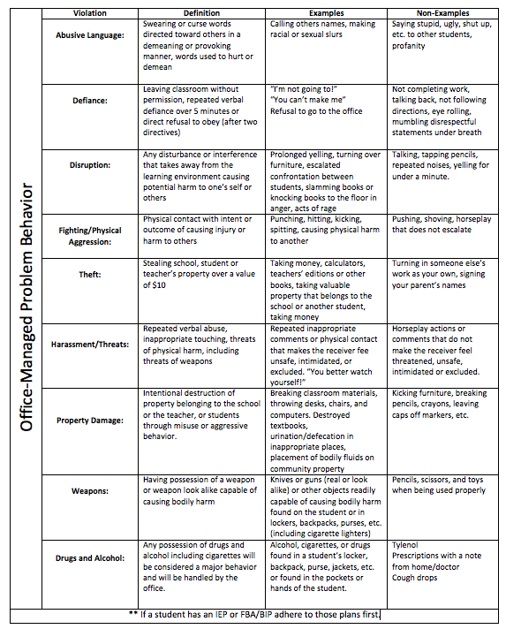
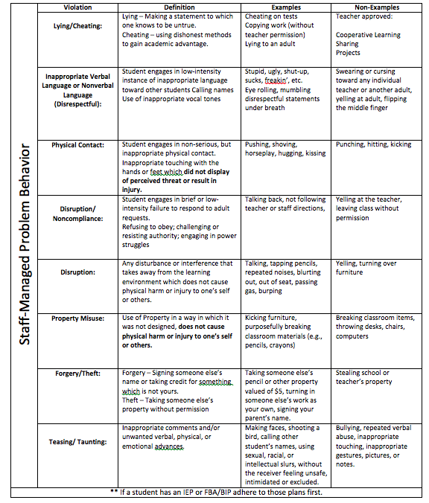
Consistent and Appropriate Response to Problem Behaviors
Reference Activity #9 in Day 2 Workbook
Notes:
One of our goals with RTI²-B is to reduce the number of problem behaviors that occur. However, while we aim for a reduction, we know that problem behaviors will still happen. Therefore, it is imperative that we as a school respond consistently and appropriately to those problem behaviors when they occur. The first step in having a consistent and appropriate response is to clearly define what the different problem behaviors are that occur most frequently in our school. We have done that here, and have categorized those behaviors as either office-managed (more severe problem behaviors that result in an Office Discipline Referral) or staff-managed (more minor behaviors that should be handled in the classroom setting).
(Have the staff read through the definitions and allow them to ask questions. You can even do an activity here and have them practice sorting the definitions into office-managed versus staff-managed and see what the agreement levels are among your staff).

Slide 18
Discipline Process Flowchart
Reference Activity #12 in Day 2 Workbook & insert your flowchart
Notes:
The next step in developing a consistent and appropriate response to problem behaviors was to create a discipline process flowchart. This flowchart is intended to be used as a teacher tool or reference sheet, and is not for student use. The goal of this flowchart is for teachers to have a quick reference on how to respond to problem behaviors when they occur. One side of the flowchart shows the process for how to handle office-managed behaviors, while the other side shows the process for staff-managed behaviors. On the staff-managed side, we have listed out different consequence options that you as a teacher can and should use when staff-managed problem behaviors occur. We know that it is sometimes difficult to think about what options are available to you as the teacher in the moment when these problem behaviors occur; so don’t hesitate to refer to the flowchart to help guide your decision-making. Our students will learn what the appropriate behaviors versus inappropriate behaviors are that they need to display at school when we as staff take on a consistent way of responding to those inappropriate behaviors.
(Take a few minutes to walk your staff through how to read and use the flowchart. Allow time for questions).

Slide 19
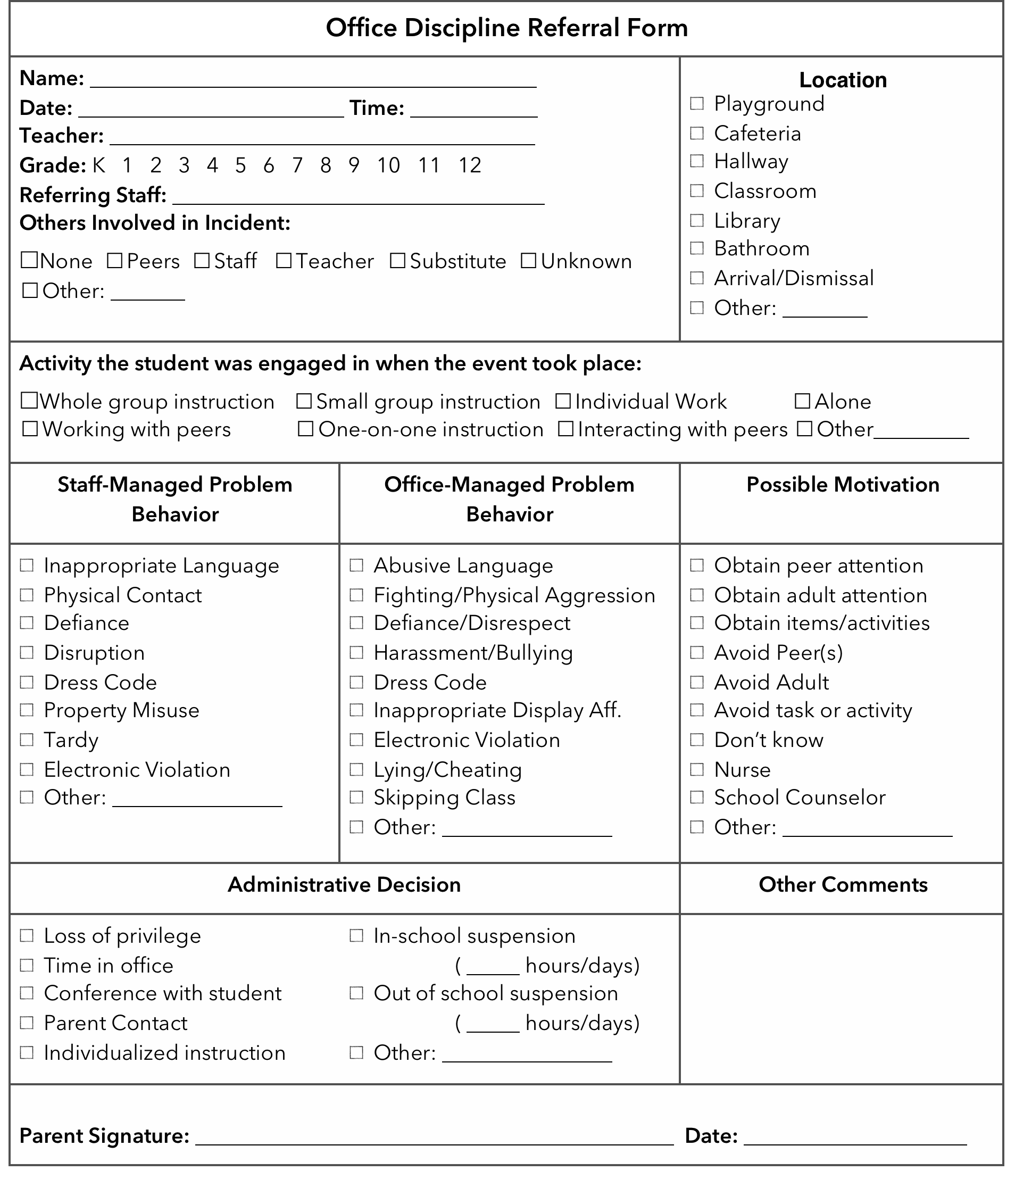
Office Discipline Referral Form
Reference Activity #13 in Day 2 Workbook & insert your ODR form
Notes:
When office-managed behaviors do occur, we need a way to keep track of them as a school. This is our school’s Office Discipline Referral Form (or ODR form). If you need to send a student to the office, you must fill out this form. This is one very important form of data that our team will be using to determine the progress that we as a school are making with RTI²-B. This is also a decision-making tool that we will use to determine if students need additional supports in the form of Tier II or Tier III.
(Review the ODR form so staff understand how to use it).

Slide 20
Professional Development for Faculty and Staff
Today’s RTI²-B training during in-service
Updates on RTI²-B at Faculty Meetings
School calendar shows RTI²-B information
Reference Activity #21 in Day 2 Workbook & insert PD plan
Notes:
(Explain your school’s plan for professional development for staff)

Slide 21
Input Needed from Faculty and Staff
Review the following materials in your folder:
  Draft of Implementation Manual
  Lesson Plans
    Grade Level Chairs have already reviewed these and provided suggestions
  Office-Managed vs Classroom-Managed Problem Behavior definitions, examples and non-examples
Please provide feedback through the online survey by Friday
Reference Activity #10 in Day 1 Workbook & insert your plan for input
Notes:
The only way that RTI²-B is going to be effective in our school is by having us as a staff on board with the plan. We all have to want to commit to following the plan. However, as we try this out, we know that there are some things in the plan that may need to change. Therefore, the RTI²-B team needs your input. We have the following ways planned out for gathering your input about the Tier I plan.
(Explain your school’s plan for gathering input from the staff about your school’s Tier I plan)

Slide 22
Acknowledgement of Faculty and Staff Participation
Worker Bee Award
  Poster displayed on classroom door of teacher (selected by Administrator and RTI²-B School Team)
  Staff are given the award for doing an exceptional job teaching/re-teaching expectations and acknowledging students with Bramble Bucks
Raffles
  After the school-wide celebration, Bramble Bucks are removed from the Beehive and placed in a box
  Bramble Bucks will be drawn from the box at the next faculty meeting, and the teacher listed on the Bramble Buck will win a prize
Beekeeper Breakfast
  Quarterly appreciation breakfasts hosted by RTI²-B School Team and PTO
  Our way of saying thank you for implementing RTI²-B
Reference Activity #18 in Day 2 Workbook & insert plan to acknowledge staff
Notes:
We know that we all have a lot on our plates. RTI²-B is not intended to be another thing to add to our already full plates. Instead, RTI²-B is intended to provide the framework for making our other initiatives, curriculums, etc. work more effectively and efficiently. However, this framework will not work without your participation, support, and collaboration. Therefore, we want to acknowledge you and thank you for your participation and support.
(Explain your school’s plan for acknowledging staff for their participation)

Slide 23
Involvement of Families and Community
Busy Bees
  Bulletin board in the front office will display names and pictures of community groups and family members who have helped with RTI²-B with a large “thank you” sign
School Website
  Running banner to highlight participation from community and family members
Thanking Members of our Beehive
  Annual celebratory event at the end of the year
  Family and community members invited
Reference Activity #18 in Day 2 Workbook and insert plan to acknowledge families
Notes:
Another goal of RTI²-B is to include families and the community more. We know that when we have family support, we tend to see better gains with our students. This is our plan for further involving our families and our surrounding community.
(Explain your school’s plan for involving families and community)

Slide 24
Data-Based Decision Making
RTI²-B Team will review data at every meeting
Data will also be shared at faculty meetings
More information regarding the specific tools will be shared at a later date
Data collection plan outlines Tier I data
Reference Activity #15 in Day 2 Workbook and insert table
Notes:
Lastly, we want to make sure that what we are doing is effective. We don’t want to just do something else for the sake of saying we’ve done it. Instead, we want to make sure that what we are doing is working for our students and our staff. Therefore, we have a number of ways that we will be using data for decision-making purposes. Our team will be reviewing data on a regular basis and sharing that data with all of you.

Slide 25
Questions?
Notes:
(Allow time for staff to ask questions, provide feedback, etc.)

