Slide 1

RTI²-B Annual Report
Bramble Elementary
2020 - 2021
Notes:
Instructions:
This is a summary of the school’s RTI2-B data for the 2020-2021 school year.
As a Tier I team, build this presentation (embedding screenshots of graphs from longitudinal annual report excel document) and discuss each piece of data for analysis using evaluation questions in the notes.
Identify a time to share presentation with school stakeholders.
Determine what conversations will be shared out with stakeholders during the presentation so that they understand the use of data.
This report is only a template for behavior data. Consider adding academic or attendance data.
Conversation topics:
Team will present annual report data using this presentation to stakeholders (including staff, families, and community members)
Provide the purpose to stakeholders – the review of annual data allows improvements to be made to the Tier I plan
As you prepare this presentation, consider what conversations need to take place with your Tier I team to best use this data in making improvements to your RTI2-B plan
Have your recorder take notes on the conversation during this presentation and any action items that come up

Slide 2
Who:
RTI²-B Team meets at least monthly to make data-based decisions.
Purpose of Reviewing Data:
Indicates school climate
Helps identify students for additional support
Shows effectiveness of school-wide, group-based, and individual interventions
Allows team to regularly problem-solve and action plan
Why do we collect data?
Notes:
Conversation topic:
Throughout the year, staff is asked to collect data that is used by the Tier I team. This annual report serves as a summary of collected data to share back with staff and assist in assessing the implementation of the RTI2-B plan.

Slide 3

Fidelity of Implementation
Tool:
Tiered Fidelity Inventory (TFI)
Purpose:
Measures extent to which the core features of RTI²-B are implemented as intended
Results are used to identify strengths and weakness of implementation at each tier and inform improvements to an RTI²-B plan
Administration:
Fall and Spring
Goal:
Increase the % of components implemented with fidelity over time
Notes:
Additional resources to share/investigate:
TFI Subscale report
TFI Item report
Tier I Implementation Snapshots https://tennesseebsp.org/team-login/coaches/ (password tbspcoaches)

Slide 4

Fidelity of Implementation
Delete this image and copy/paste graph from annual report here.
Notes:
This graph represents the TFI Scale Scores for the Spring TFI.
X axis: year of implementation
Y axis: percentage of points received out of total number of points possible
Goal line: 80%
Evaluation questions for staff:
What is our baseline at Tiers I, Tier II, and Tier III?
Has our RTI2-B implementation improved across years?
How are we doing in our Tier II and Tier III implementation?
Have we met the 80% goal (represented by the purple line on the graph) of implementation at any tier?
Refer to your Subscale Report. Is there a subscale that needs to be focused on?
Refer to your Item Report, identify specific items that your team would like to focus on.

Slide 5
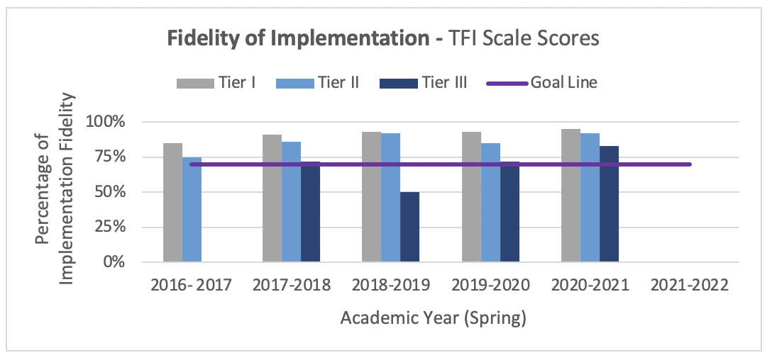
Fidelity of Implementation
Notes:
This graph represents the TFI Scale Scores for the Spring TFI.
X axis: year of implementation
Y axis: percentage of points received out of total number of points possible
Goal line: 80%
Evaluation questions for staff:
What is our baseline at Tiers I, Tier II, and Tier III?
Has our RTI2-B implementation improved across years?
How are we doing in our Tier II and Tier III implementation?
Have we met the 80% goal (represented by the purple line on the graph) of implementation at any tier?
Refer to your Subscale Report. Is there a subscale that needs to be focused on?
Refer to your Item Report, identify specific items that your team would like to focus on.

Slide 6
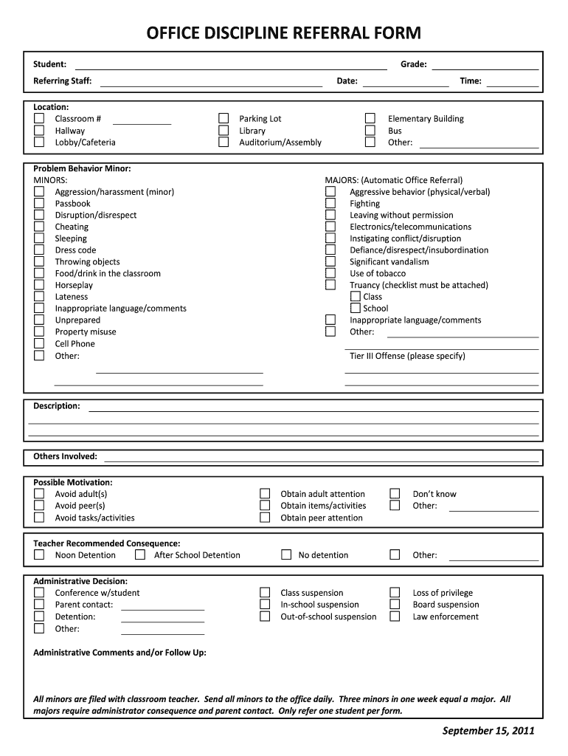
Office Discipline Referrals
Tool:
Office discipline referrals (ODRs)
Purpose:
Systematically document problem behavior data
Used in conjunction with other data sources to
  Identify patterns of behavioral concern
  Problem-solve at schoolwide, classroom, and individual levels
  Determine areas and behaviors for re-teaching
  Adjust RTI²-B systems and practices to meet students’ needs
Administration:
Ongoing
Goal:
Increase the percentage of students who receive few (i.e., 0-1) ODRs
Notes:
Additional Resources to share/investigate:
Review SWIS data
ODR Review https://tennesseebsp.org/wp-content/uploads/2020/08/ODR-Review.docx
Questions to Consider when reviewing ODR data: https://tennesseebsp.org/wp-content/uploads/2021/03/Questions-to-Consider-for-ODR-Data.pdf
Cost benefit worksheet helps with staff buyin and assessing time loss by dealing with ODRs to emphasize prevention https://tennesseebsp.org/wp-content/uploads/2016/02/Missouri-ODR-Cost-Benefit-Spreadsheet.xlsx

Slide 7
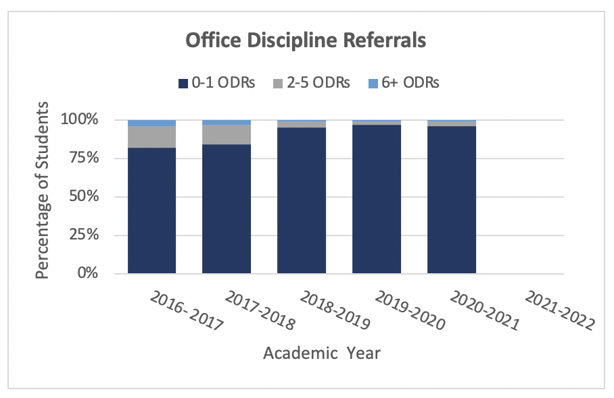
Office Discipline Referrals
Notes:
This graph represents the percentage of students with ODRs falling into the 0-1, 2-5, and 6+ range.
X axis: Academic year
Y axis: percentage of students who received ODRs within the specified range
Goal: Increase the percentage of students who receive few (i.e., 0-1) ODRs. The goal is that at least 80% of your students have 0-1 ODR.
Evaluation questions for staff:
How has the percent of students who received 0-1 ODRs changed from year to year?
How has the percent of students who received 2-5 ODRs changed from year to year?
Are there improvements we can make to document behavior incidents more consistently?
Is our data accurately capturing what is happening in our building?
How might the school’s most recent ODR counts inform further development of the school’s RTI2-B plan?
How does our data compare to the goal of 80% of our students falling within the 0-1 ODR range?

Slide 8
Tool:
Student Risk Screening Scale for Internalizing and Externalizing Behaviors (SSRS-IE)
Purpose:
Assesses level of risk for internalizing and externalizing behavioral concerns
Used with other data sources to
  Determine the level of support needed for students
  Adjust RTI²-B systems and practices, especially at the school-wide level
Administration:
Fall, Winter, and Spring
Goal:
Adjust RTI²-B systems and practices to address student need and reduce risk for developing risky behaviors
Universal Behavior Screening
Notes:
Additional Resources to share/investigate:
Using your SRSS data https://tennesseebsp.org/blog/
Evaluating data to assess intervention needs https://tennesseebsp.org/wp-content/uploads/2021/03/Mar2021_ImplementorSpotlight.pdf

Slide 9
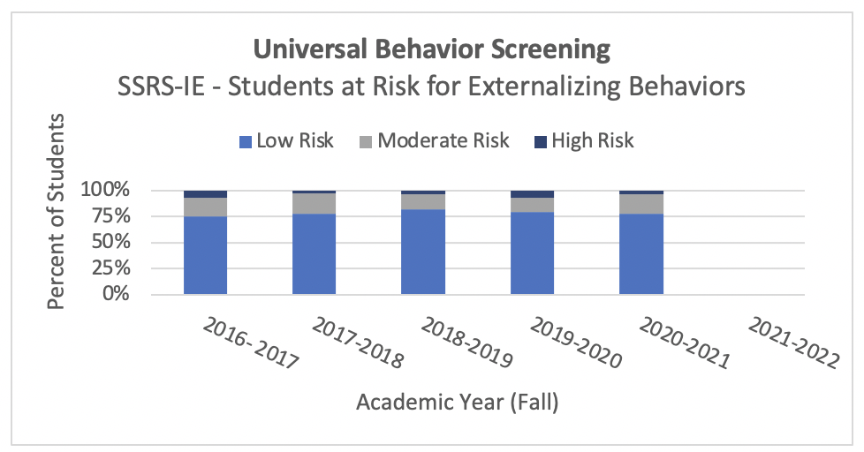
Universal
Behavior Screening
Externalizing Behaviors
Notes:
This graph represents the school’s fall screener scores for externalizing behaviors.
X axis: year of implementation
Y axis: percentage of screened students at risk for externalizing behavior
Goal: at least 80% of your students will fall into the externalizing low risk category
Evaluation questions for staff:
How have risk levels changed from year to year?
How might our most recent scores inform further development of our RTI2-B implementation plan.
What prevention or adjustments to your Tier I plan need to be made if less than 80% of your students are falling within the low risk range.
How does our data compare to the goal of 80% of our students falling within the low risk range?
Are there any interventions we should consider adding next year (school-wide, small group, or individual interventions)

Slide 10
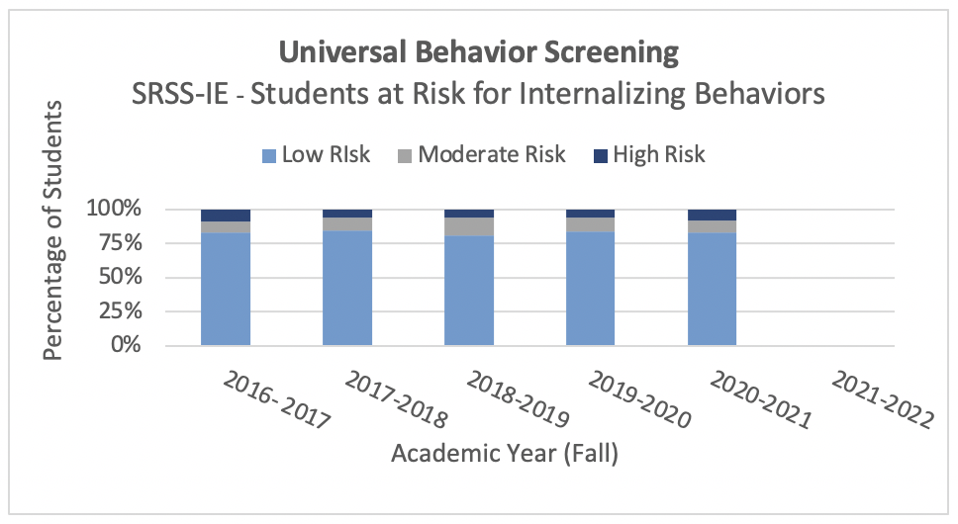
Universal
Behavior Screening
Internalizing Behaviors
Notes:
This graph represents the school’s fall screener scores for internalizing behaviors.
X axis: year of implementation
Y axis: percentage of screened students at risk for internalizing behavior
Goal: at least 80% of your students will fall into the internalizing low risk category
Evaluation questions for staff:
How have risk levels changed from year to year?
How might our most recent scores inform further development of our RTI2-B implementation plan.
What prevention or adjustments to your Tier I plan need to be made if less than 80% of your students are falling within the low risk range.
How does our data compare to the goal of 80% of our students falling within the low risk range?
Are there any interventions we should consider adding next year (school-wide, small group, or individual interventions)

Slide 11
Social Validity
Tool:
Primary Intervention Rating Scale (PIRS)
Purpose:
Measures perceived acceptability, social importance, and effectiveness of Tier I supports, as measured by staff and stakeholder input
Results are used to drive continuous improvement of an RTI²-B implementation plan
Administration:
Spring
Goal:
Continuous improvement of RTI²-B implementation, yielding positive or improved perceptions of a Tier I plan by school staff over time
Notes:
Additional Resources to share/investigate:
Social validity brief: https://tennesseebsp.org/wp-content/uploads/2019/03/Final-TBSP-Social-Validity-brief-.pdf
SWOT analysis template: https://tennesseebsp.org/wp-content/uploads/2021/03/SWOT-Analysis.pdf

Slide 12
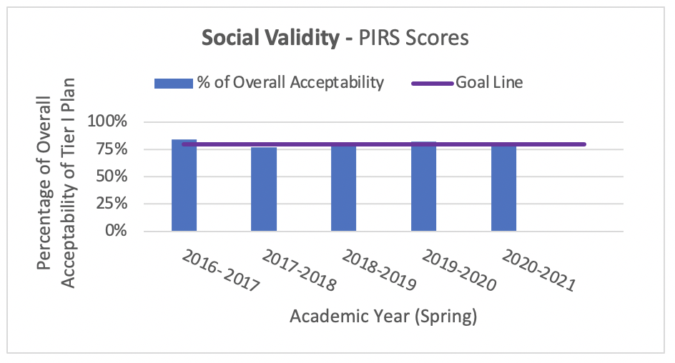
Social Validity
Notes:
This graph represents the results of the PIRS survey
X axis: academic year
Y axis: percentage of overall acceptability or staff buy-in of the Tier I plan
Goal line: represents 80% acceptability from at least 50% of your staff
Evaluation questions for staff:
How have staff perceptions of our school’s RTI2-B implementation plan changed over time?
How might the number staff who responded each year affect how we interpret this data?
How has the team used input from the PIRS to make changes to the plan?
How does our school’s acceptability score compare to the goal of 80%?
Did 50% of your staff participate? If not, how can you encourage more participation in the future?
What themes emerged from the short answer questions? (need access to the PIRS results report)
Consider your training plan for the fall and what resources will need to be provided.

Slide 13
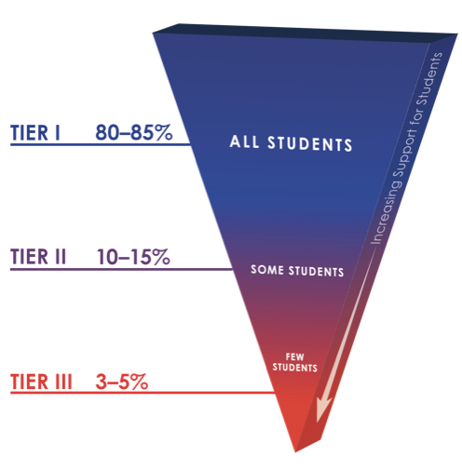
RTI²-B Support by Tier
Tools:
Count of students supported by each tier
Purpose:
The count of students supported by each tier is used to evaluate the effectiveness of the RTI²-B framework
Administration:
Ongoing throughout the school year
Goal:
Establish a continuum of practices that match student need
80% of students only requiring Tier I support
10-15% of students needing additional Tier II support
3-5% of students needing intensive Tier III support
Notes:
Conversation topic:
Be sure to revisit and revise your Implementation Manual each year to update and make changes to your plan based on discussions held during this presentation.
Additional Resources to share/investigate:
Tier I Resource Binder: https://tennesseebsp.org/wp-content/uploads/2020/10/20-21-Tier-I-Resource-Binder.pdf
School Resource Mapping: https://tennesseebsp.org/wp-content/uploads/2021/03/School-Resource-Mapping-Activity.doc

Slide 14
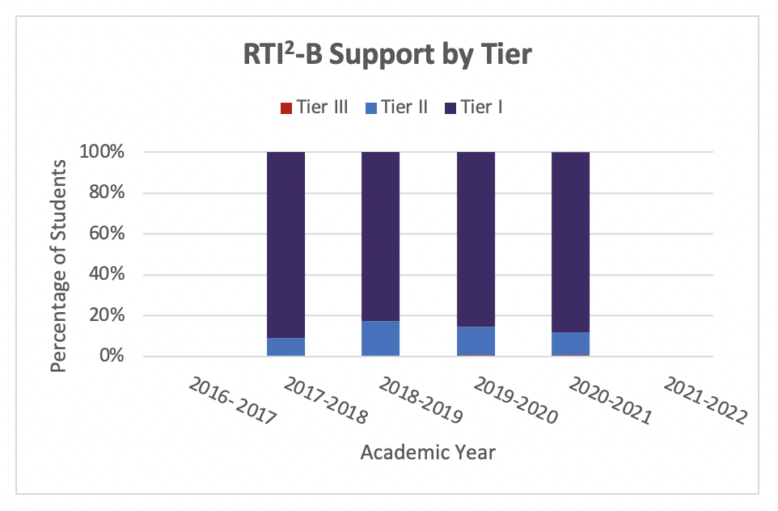
RTI²-B Support by Tier
Notes:
This graph represents the percentage of students in your school supported at each Tier.
X axis: academic year
Y axis: percentage of students supported by tier
Goal: prevent the number of students needing additional interventions and supports.
About 80% of your students should respond positively to only receiving Tier I supports
10-15% supported in Tier II
3-5% supported in Tier III
Evaluation questions for staff:
How has the number of students in each tier changed over time?
Is our school supporting approximately 80% of students in Tier I, 10-15% of students in Tier II, and 3-5% in Tier III
If less than 80% of students are supported in Tier I, how might this information inform the development of our RTI2-B plan
Reevaluate interventions currently offered. Do any need to be added school-wide, small group, or individual?

Slide 15
Tier II Support
Tools:
Count of students supported by Tier II intervention
Count of students successfully exited from Tier II support
Purpose:
Used in conjunction with other data to evaluate level of use of Tier II interventions and effectiveness of Tier II supports
Administration:
Comparison of end-of-year data
Goal:
Establish Tier II systems and practices that adequately address the needs of at least 5% (and up to 10-15%) of students
Notes:
Additional Resources to investigate/share:
Tier II Resource Binder: https://tennesseebsp.org/wp-content/uploads/2020/10/20-21-Tier-II-Resource-Binder.pdf
Progress Monitoring Tool Guide: https://tennesseebsp.org/wp-content/uploads/2020/09/TBSP-Progress-Monitoring-Tool-Guide.pdf
Progress Monitoring Tool: https://tennesseebsp.org/wp-content/uploads/2020/09/TBSP-Progress-Monitoring-Data-Tool.xlsm
Intervention Audit: https://tennesseebsp.org/wp-content/uploads/2020/09/Tier-II-Intervention-Audit-Activity.docx

Slide 16
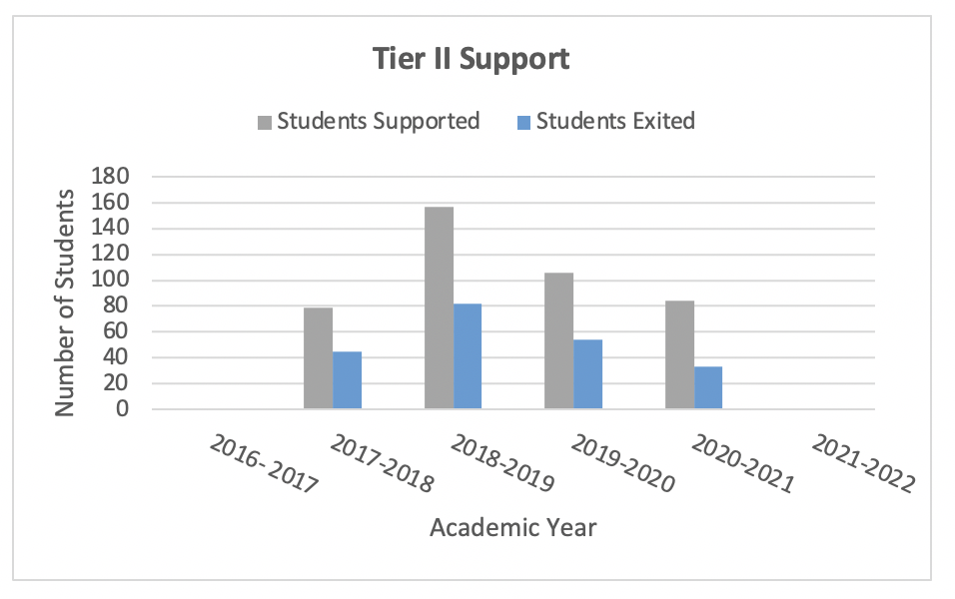
Tier II Support
Notes:
This graph represents the number of students supported by Tier II as well as the number of students who successfully exited from Tier II interventions.
X axis: academic year
Y axis: Number of students
Goal: The goal is to have a Tier II system that adequately addresses the needs of at least 5% (and up tp 10-15%) of students
Evaluation questions for staff:
How has the number of students receiving Tier II support changed over time?
Is our school supporting approximately 10-15% of students at Tier II?
If more than 10-15%: How might this information inform the development of our RTI2-B plan?
Ensure that interventions are being implemented with fidelity and matched to student need.

Slide 17
Tier III Support
Tools:
Count of Functional Behavior Assessments (FBAs) completed
Count of Behavior Support Plans (BSPs) completed
Purpose:
Used in conjunction with other data to evaluate level of use of Tier III supports
Administration:
Comparison of end-of-year data
Goal:
Establish Tier III systems and practices that adequately address the needs of 1-5% of students
Notes:
Additional Resources to investigate/share:
Tier III Resource Binder: https://tennesseebsp.org/wp-content/uploads/2020/11/Tier-3-Binder.pdf

Slide 18
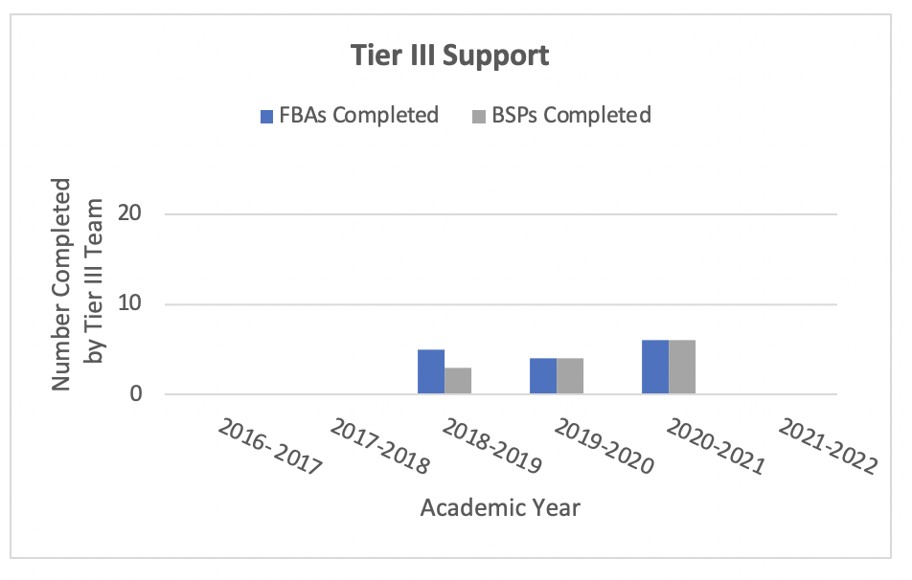
Tier III Support
Notes:
This graph represents the number of FBAs and BSPs that have been completed in Tier III.
X axis: academic year
Y axis: Number of FBAs or BIPs completed by Tier III Team
Goal: The goal is to establish Tier III systems and practices that adequately address the needs of 1-5% of students.
Evaluation questions for staff:
How has the number of students receiving Tier III support changed over time?
Is our school supporting approximately 1-5% of students at Tier II?
If more than 5%: How might this information inform the development of our RTI2-B plan?
Ensure that interventions are being implemented with fidelity and match the student’s function of behavior.

